Slide 1
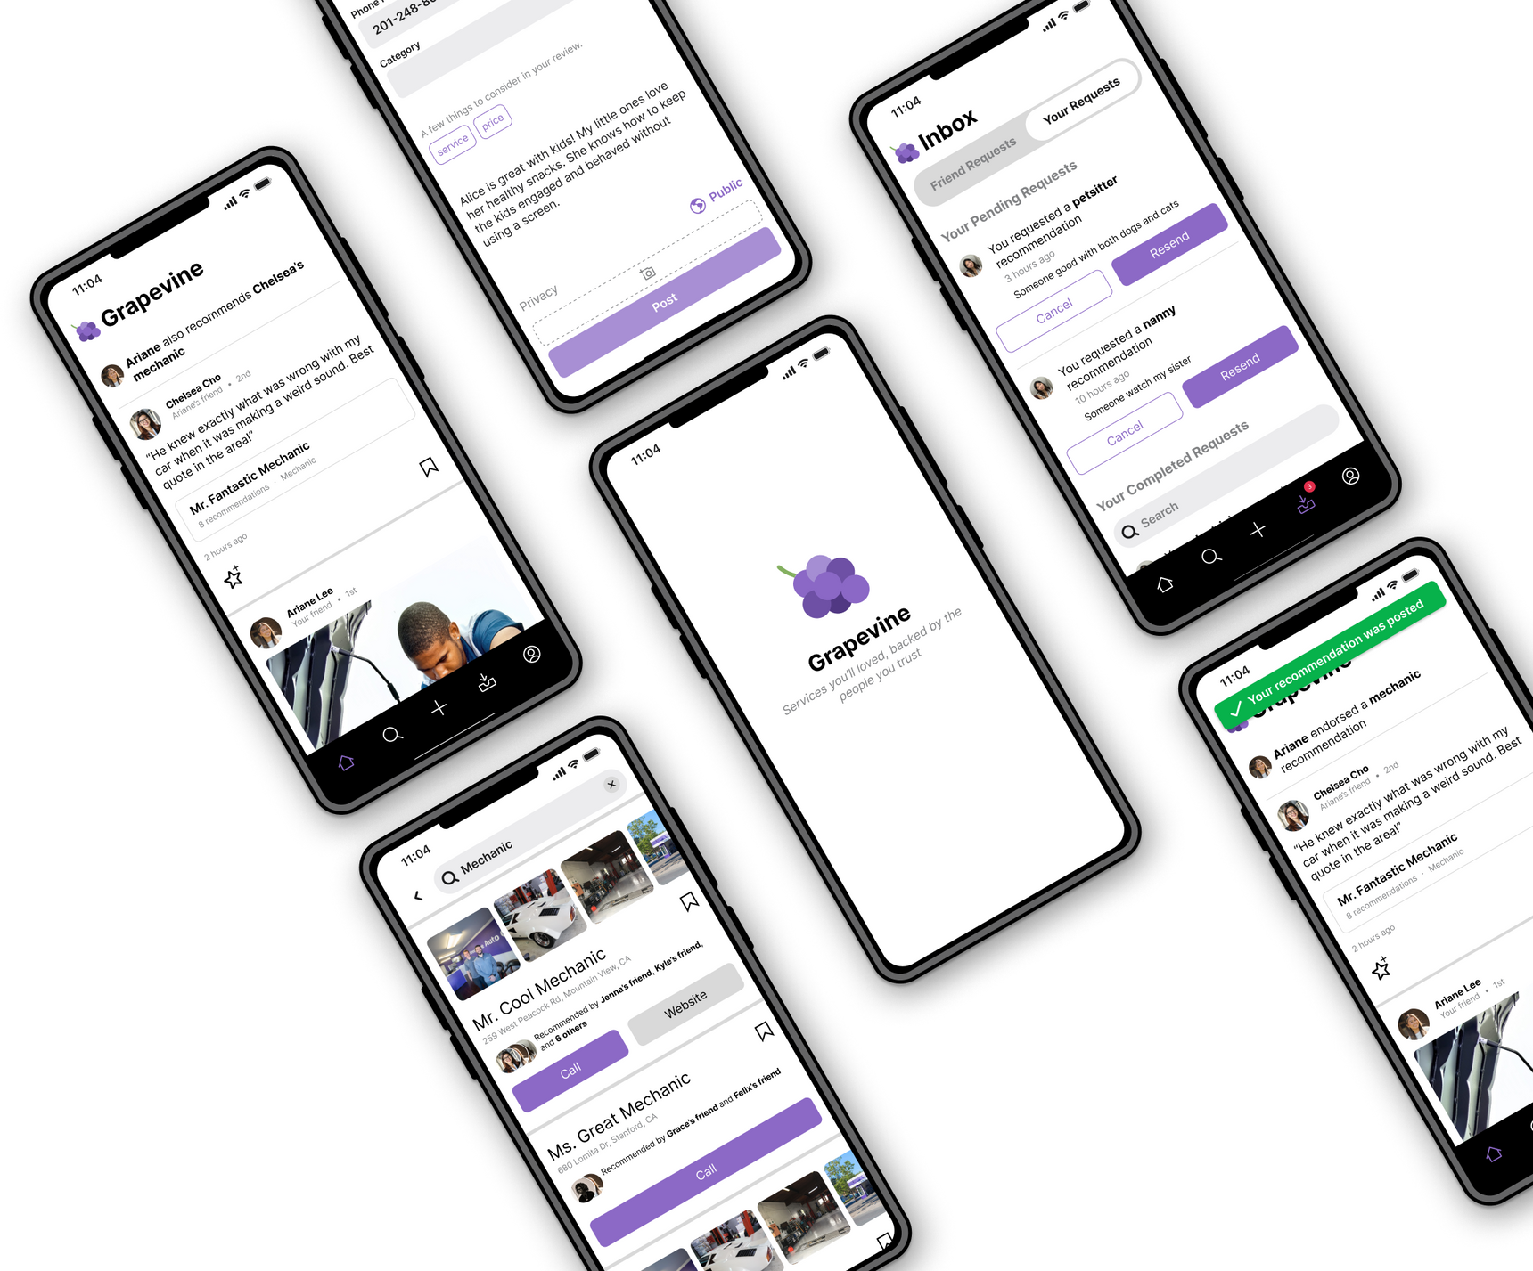

Studio: Unintentional Good
A6:
INTERACTIVE PROTOTYPE

Slide 2
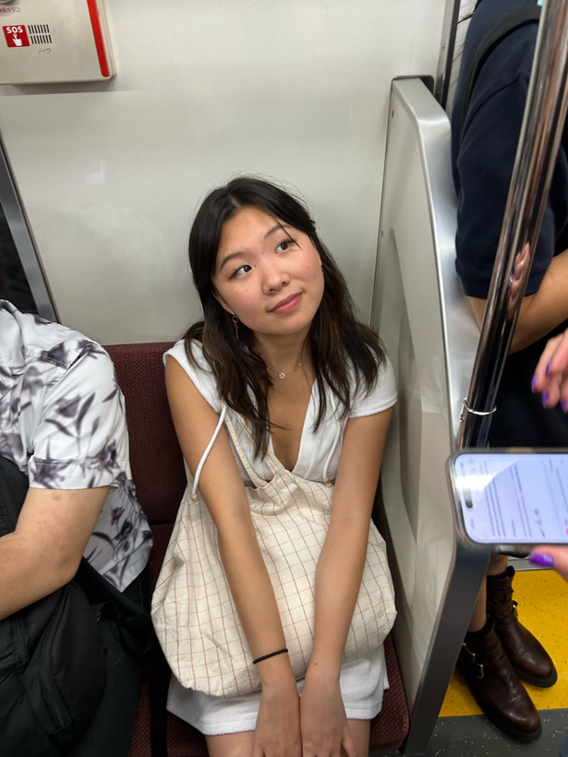


The Team
Emily Deng
Jenna Kim
Ariane Lee
Ariane Lee
Computer Science ‘25
Computer Science ‘25
Symbolic Systems ‘25
Computer Science ‘25

Slide 3
What's Inside
01 | Title & Value Prop
02 | Problem & Solution
03 | Encoded Values
04 | Tasks
05 | Usability Goals & Key Measurements
06 | Revised Interface Sketches
07 | Simple Task Prototype

Slide 4
01
Grapevine

Slide 5

THE NAME
People often say they hear things “through the grapevine” aka to hear something from someone else they know
“Through the grapevine” also implies that the information has been passed along in a word-of-mouth fashion
GRAPEVINE
Most people
know the phrase “through the grapevine”
BEHIND THE NAME
We thought that “Grapevine” would effectively communicate that our app is social and relates to hearing about things from your network, whether its your own friend or friend of a friend

Slide 6
VALUE PROPOSITION
Services you’ll love backed by people you trust.

Slide 7
Problem
Solution
People find it difficult to find services that suit their personal needs, and online reviews from strangers are often unhelpful with the search.
A service recommendation app where you can see and request recommendations from 1st, 2nd, and 3rd degree friends for services like plumbers, mechanics, nannies, etc.

Slide 8
03
Encoded Values

Slide 9




Encoded Values
Community
Personalization
Transparency
Efficiency
Our app strives to build a stronger community by bringing together adjacent networks (friends of friends) while also promoting smaller businesses who may not gain recognition on larger databases.
Unlike Google or Yelp, Grapevine provides personalized recommendations based on what friends or friends of friends are thinking. People related to you typically have more similar values to you than strangers.
In terms of services, people are generally more trustful of friend recommendations over public reviews because they know where the information is coming from.
Grapevine seeks to make the process of asking friends for recommendations more efficient by centralizing the information, streamlining the process, and connecting adjacent networks.

Slide 10
Encoded Values
Features:
Seeing recommendations from up to three degrees of separation away
Expressing your gratitude for a recommendation by “endorsing” it
Recommendations for a singular business mean a lot more when there are less reviews in general
Community
Our app strives to build a stronger community by bringing together adjacent networks (friends of friends) while also promoting smaller businesses who may not gain recognition on larger databases.

Slide 11
Encoded Values
Features:
Only seeing recommendations from people you know, or know through someone else
Being able to click on who has recommended a business in order to further analyze if their priorities/values align with yours
Personalization
Unlike Google or Yelp, Grapevine provides personalized recommendations based on what friends or friends of friends are thinking. People related to you typically have more similar values to you than strangers.

Slide 12
Encoded Values
Features:
Unlike reviews, which may be low or high for no apparent reason, recommendations are a simple, positive endorsement that are typically associated with some explanation
People can see who has recommended what
It is much more difficult to generate fake reviews on a platform that relies on leveraging personal networks
Transparency
In terms of services, people are generally more trustful of friend recommendations over public reviews because they know where the information is coming from.

Slide 13
Encoded Values
Features:
Users can immediately see all their friends’ (and extended friends’) recommendations for a type of service by searching it
Users can easily request a service recommendation from their entire network with a few clicks
Users don’t have to ask friends to ask other friends for information; they can do it themselves
Efficiency
Grapevine seeks to make the process of asking friends for recommendations more efficient by centralizing the information, streamlining the process, and connecting adjacent networks.

Slide 14
Value Tensions
User activity (requests and recommendations) is automatically shared with people up to three degrees away
Services (ie. doctors) can be personal, people don’t want to share
This transparency in user recommendations potentially conflicts with efficiency, as the platform is only efficient if people upload their information
We attempt to resolve this by giving users different anonymity options when they request or create a recommendation.
Transparency
Efficiency
In terms of services, people are generally more trustful of friend recommendations over public reviews because they know where the information is coming from.
Grapevine seeks to make the process of asking friends for recommendations more efficient by centralizing the information, streamlining the process, and connecting adjacent networks.

Slide 15
Value Tensions
App provides a personal experience based on what those around you prefer
Potential to create “echo chambers” where large networks of people use the same few services
Could leave out certain businesses while heavily promoting others, exacerbating the different levels of success a business can experience
We attempt to resolve this by only allowing for positive recommendations, not negative reviews.
Community
Personalization
Our app strives to build a stronger community by bringing together adjacent networks (friends of friends) while also promoting smaller businesses who may not gain recognition on larger databases.
Unlike Google or Yelp, Grapevine provides personalized recommendations based on what friends or friends of friends are thinking. People related to you typically have more similar values to you than strangers.

Slide 16
04
Tasks

Slide 17
SIMPLE TASK
Searching for a recommendation
What we changed:
Removing the toggle to “See Recs from Friends of Friends”
Making recommendations from up to 3 degrees away automatically be visible
No map as the backdrop of search
“No recommendations found” pops up as a small window instead
Search results offer more details on who has recommended as well as business number, address, and website

Slide 18
MODERATE TASK
Leaving a recommendation
What we changed:
No “suggested services” pop up when you open up the search tab to leave a recommendation
No “add a business profile” button; upon search, businesses that are on the app will only ask the user for a written review, while businesses that aren’t will lead to a screen that promps the user for more information (phone number, website, etc.)
Greyed out the post button if it is not ready to post
Users can choose to post with their name and profile visible or stay semi-anonymous
E.g. “Tobey recommends this mechanic” vs. “Chelsea’s friend recommends this mechanic”

Slide 19
COMPLEX TASK
Requesting a recommendation from your network (including friends of friends); passing on a recommendation request to your friends
What we changed:
We got rid of the “passing on a recommendation request” feature—all recommendation requests will go out to as many degrees of separation away as the user specifies
Request a recommendation is available from pop-up that says no results in search page
Requests from friends and from yourself can be seen in an organized format in the inbox page

Slide 20
05
Usability Goals & Key Measurements

Slide 21
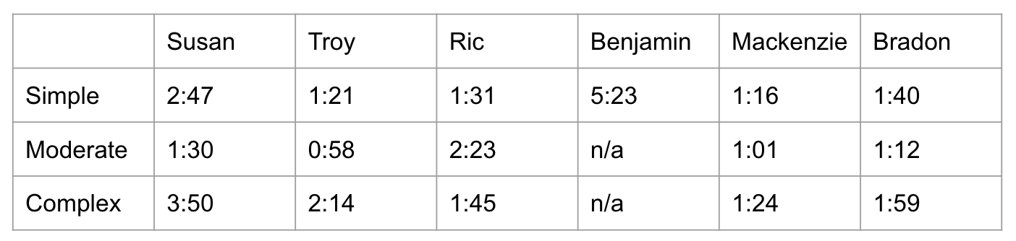
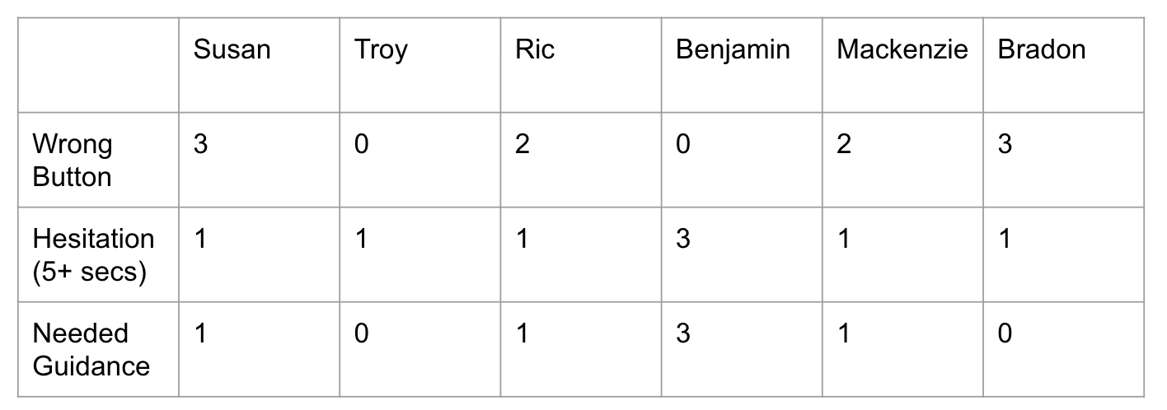
USABILITY GOAL: EFFICIENCY
How long does it take to complete each of the tasks?
USABILITY GOAL: ROBUSTNESS
How many mistakes did the users m﻿ake to complete their tasks?

Slide 22
From Last Week:
Efficiency: B Robustness: B-
Overall, participants took longer than we expected to complete all the tasks, especially simple. A critical mistake was navigating down a wrong path, which led to many wrong buttons. However, all users were eventually able to complete all the tasks with some prompting.

Slide 23
How we are progressing
We have cut down on screens and gotten rid of more complicated or somewhat irrelevant functionality. We have also designed a cleaner UI that utilizes icons and flows that are reminiscent of other apps such as Instagram and Yelp. Ideally, these changes will make the Grapevine app more intuitive and allow the user to navigate faster and make less mistakes.

Slide 24
06
Revised Interface Sketches

Slide 25
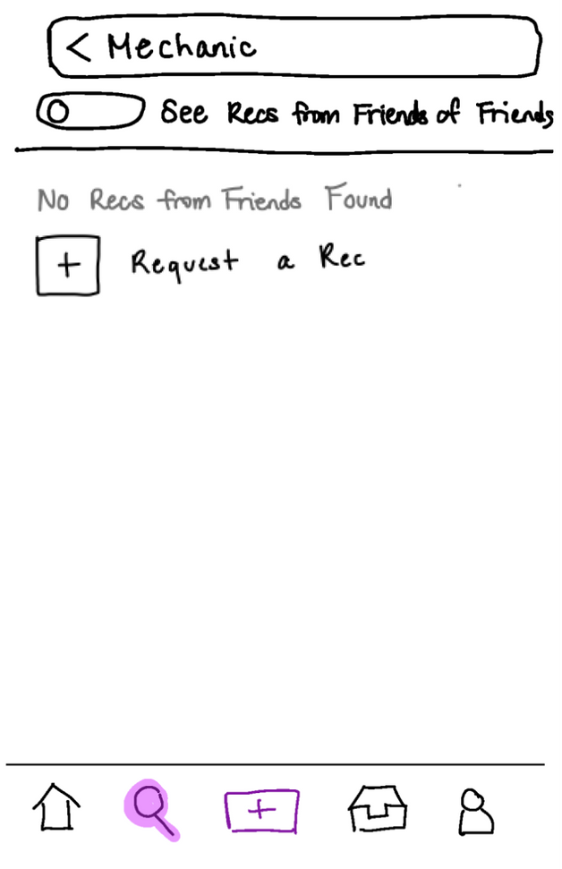
Major Design Change #1:
Toggling more Recs
📝: Finding a recommendation through search (simple)
Requesting Recommendations
Last week, we noticed that when no 1st degree friend recommendations appeared, many participants defaulted to requesting recommendations. Instead, we wanted users to to first toggle the results setting and also see recommendations from 2nd degree friends.
Previously

Slide 26
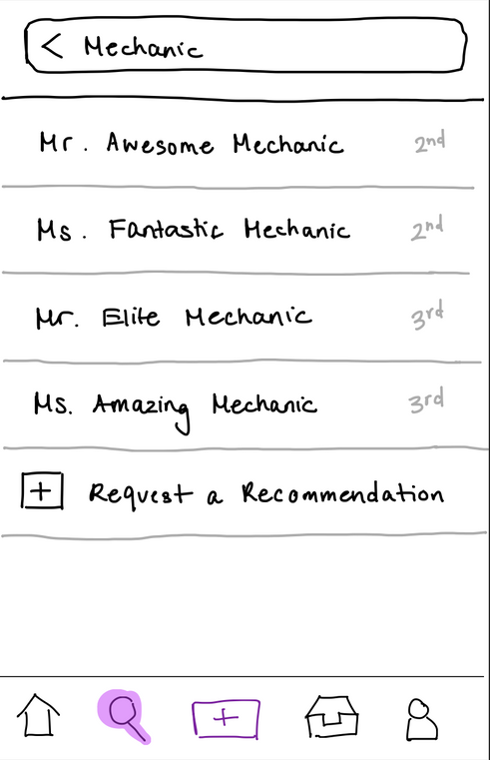
Major Design Change #1
What we changed:
Removed the toggle to “See Recs from Friends of Friends”
Made recommendations from 1-3 degrees away automatically visible
What we hope to achieve:
Users can see more results with each search
Less options/toggles --> simpler interface

Slide 27
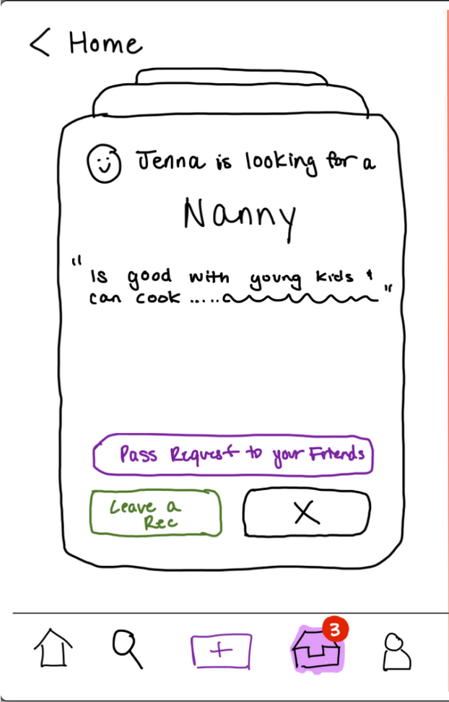
Major Design Change #2
📝: Requesting a recommendation (complex)
By automatically displaying results from up to 3 degrees of separation away, we also had to modify the complex task: requesting a recommendation. Previously, users would only send out recommendation requests to their immediate network, and these friends could then choose to pass the request on to their friends.
Previously

Slide 28
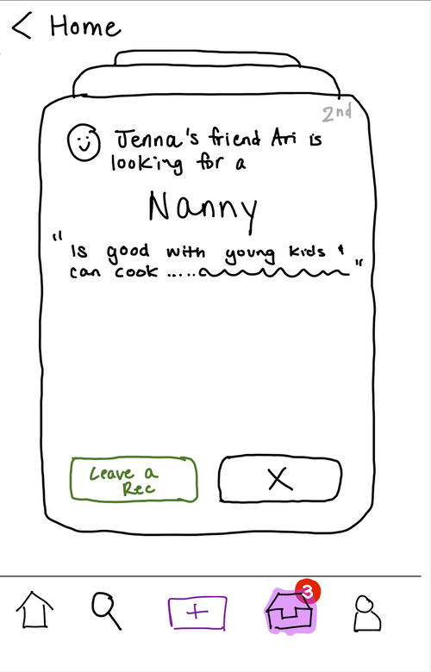
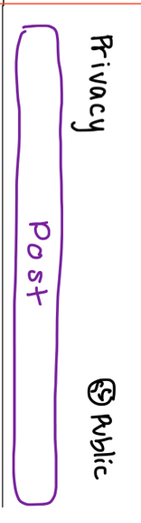
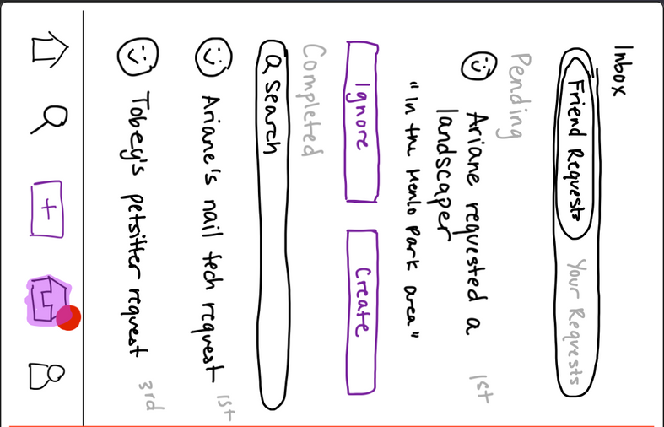

Major Design Change #2
What we changed:
Eliminated the notion of passing on requests to other friends
Senders specify how many degrees away they want requests sent (based on feedback from studio)
What we hope to achieve:
By automatically sending requests to a larger network, requests are more likely to be fulfilled
By adding modifiable privacy settings, users will feel more comfortable asking for services like doctor or therapist

Slide 29
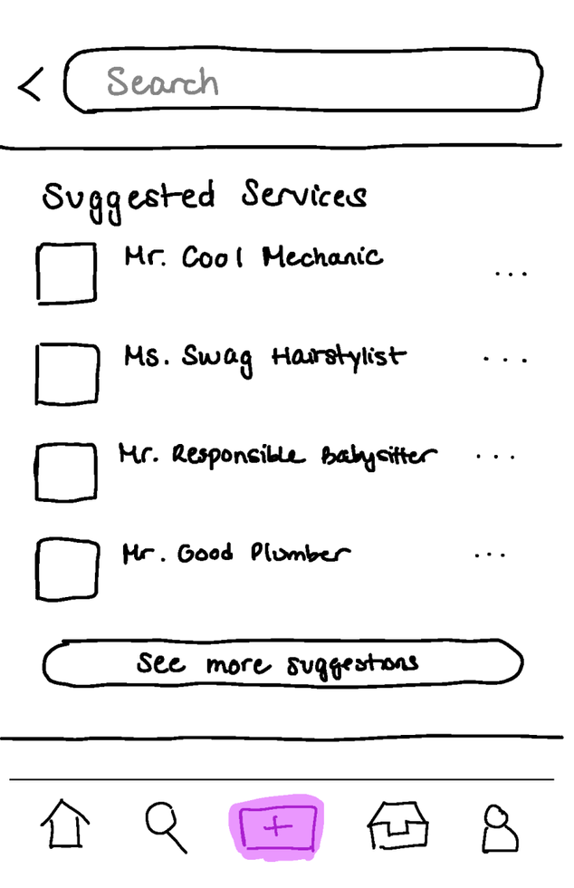
Major Design Change #3
📝: Leaving a recommendation (moderate)
Last week, we noticed that having a “Suggested Businesses” backdrop as people were trying to leave a recommendation was confusing, as it was too similar to the search tab.

Slide 30

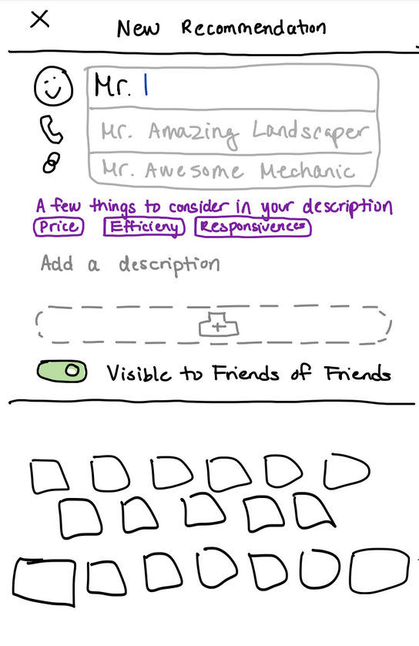
How we fixed this
What we changed:
No suggested businesses when you leave a review.
Instead, the users search for the business they want to recommend, and if it exists in the grapevine, they will add their recommendation to the existing business profile. If not, users can choose to add more details like phone number and website.
What we hope to achieve:
Less confusion to users with no suggested services backdrop
By maintaining the notion of business profiles, key information such as number and website will autopopulate with what a past user has specified --> faster task flow

Slide 31
07
Medium-Fi Task Flows

Slide 32
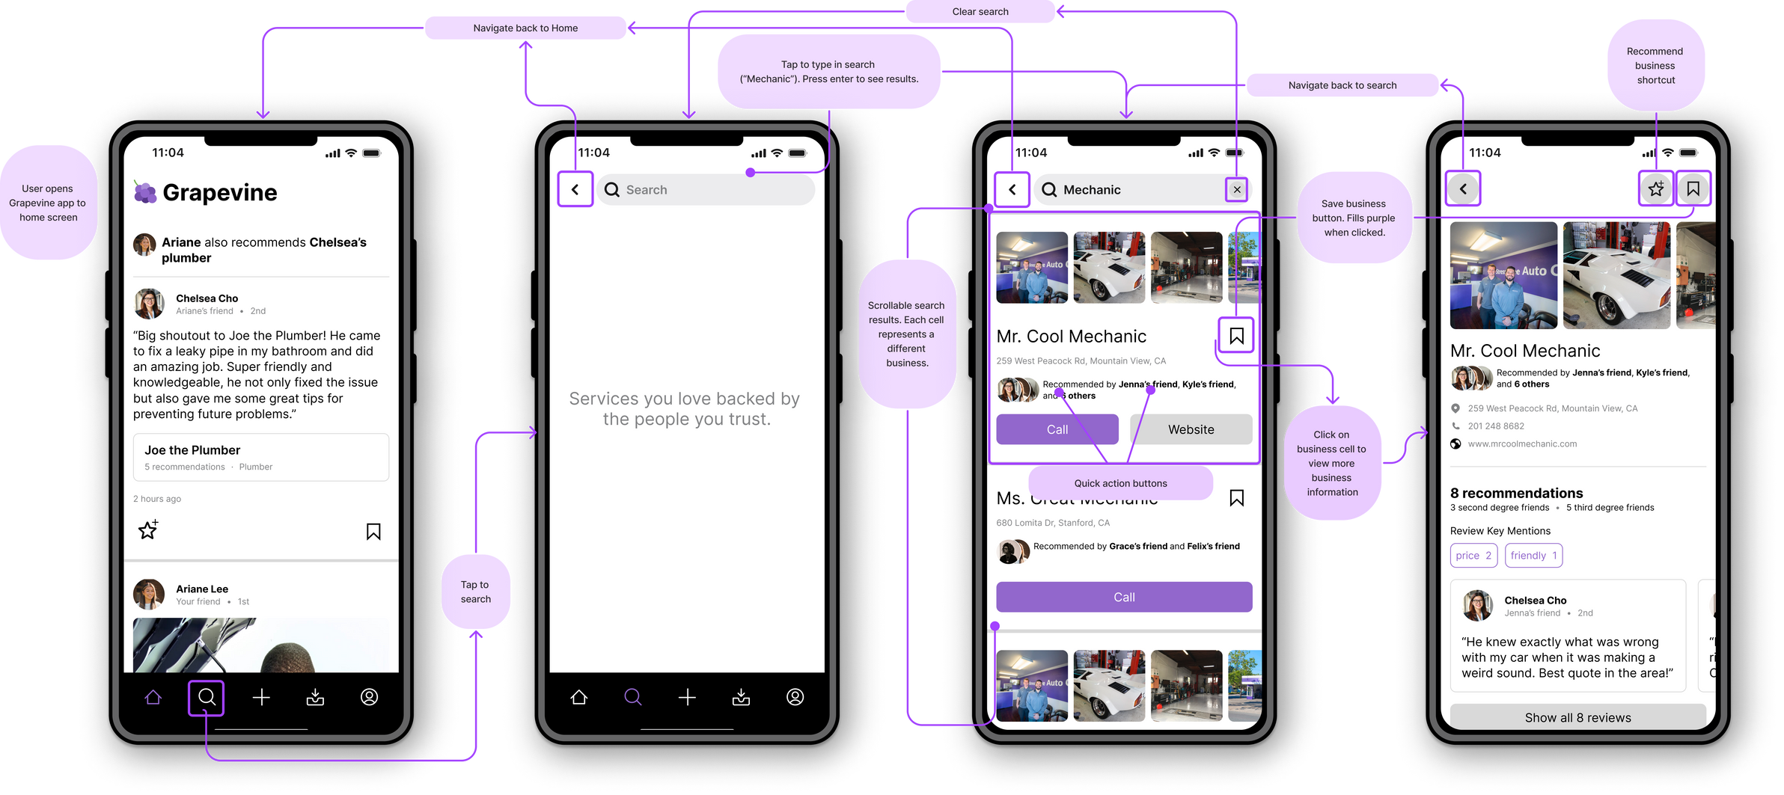
Interactive Figma Prototype
SIMPLE TASK
Searching for a recommendation

Slide 33
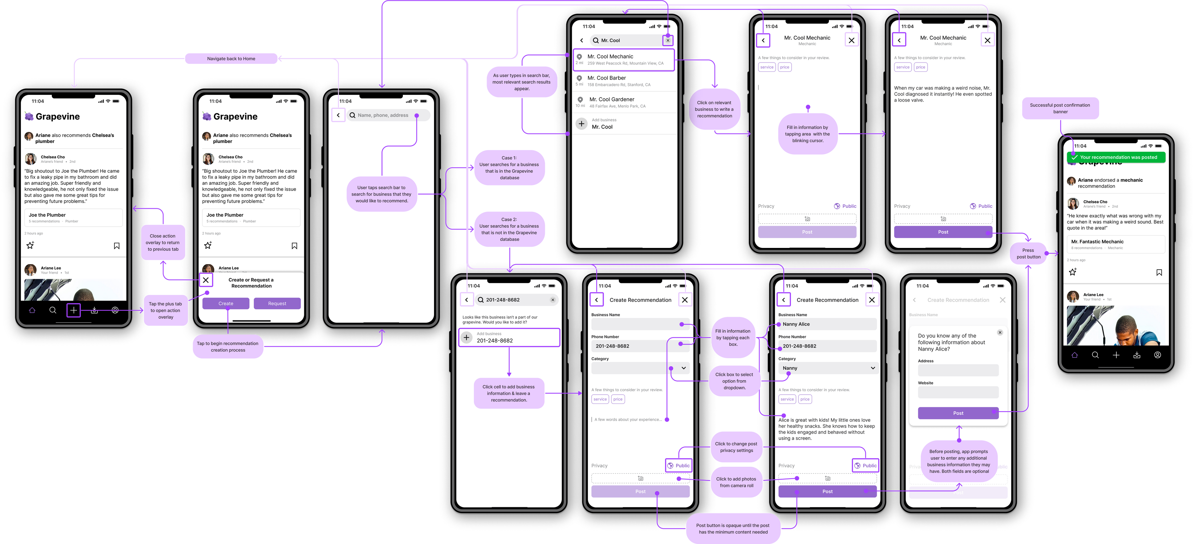
Interactive Figma Prototype
MODERATE TASK
Leaving a Recommendation

Slide 34
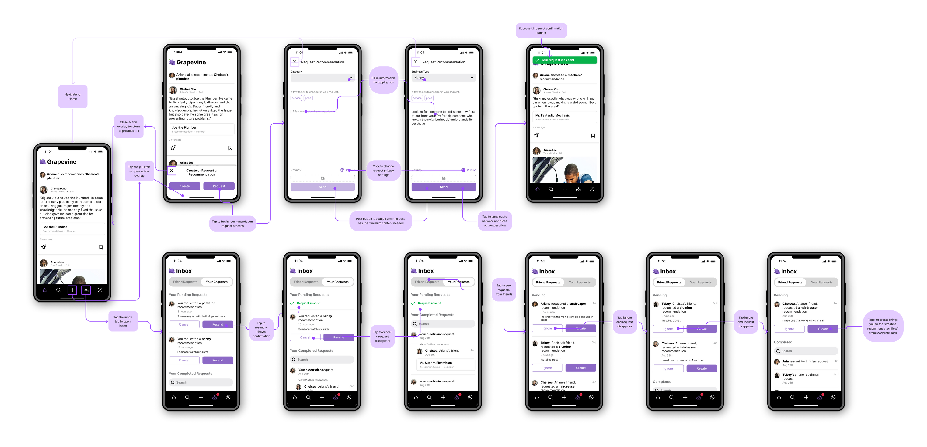
Interactive Figma Prototype
COMPLEX TASK
Requesting a recommendation from your network (including friends of friends); passing on a recommendation request to your friends

Slide 35
08
Prototype Implementation

Slide 36
Figma
Back to Agenda Page
Live, collaborative editing
Component libraries, grid systems, shapes
Can animate (prototype) buttons and features
Managing many screens was difficult without comprehensive search capabilities
Creating prototype animations was fidgety
Limited offline access
Icon Plugins (IconDuck, Streamline Icons)
Apple Design Resources Figma Template
Plugins & Templates
Pros
Cons

Slide 37
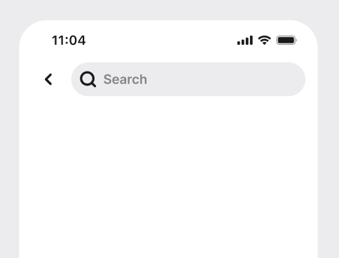
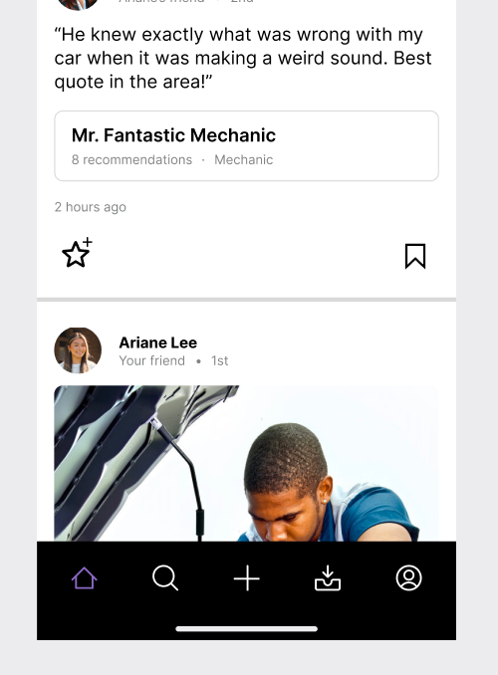

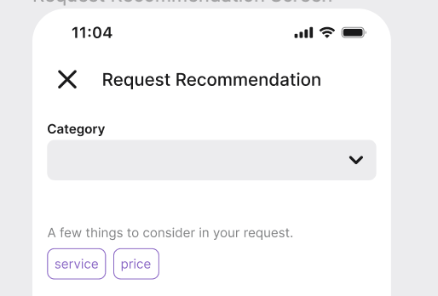
Limitations
Back to Agenda Page
User cannot input personal profile information
User cannot add friends
User cannot actually search for recommendations or request recommendations amoung their network (beyond the results we hard-coded)
No real business profiles to browse
Cannot save posts

Slide 38
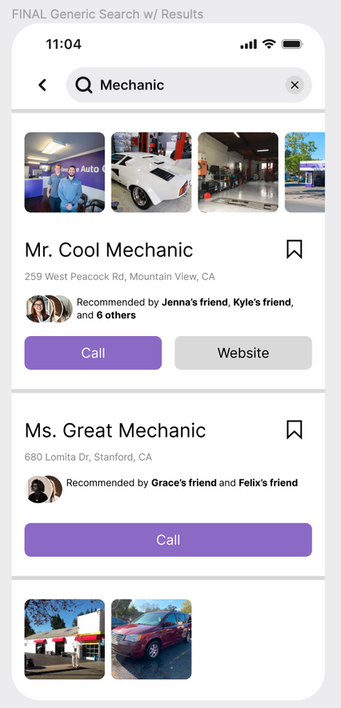
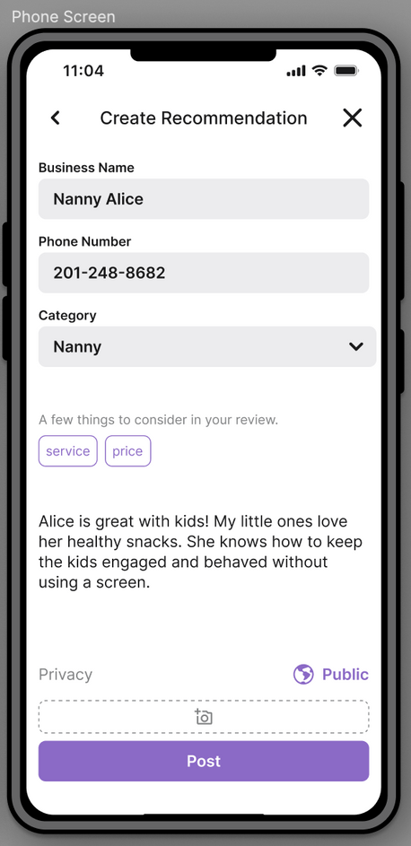




Wizard of Oz
Back to Agenda Page
Searches, search results, business details, and more auto-populate when user clicks on the text box; no functioning keyboard
User is magically given friend network

Slide 39
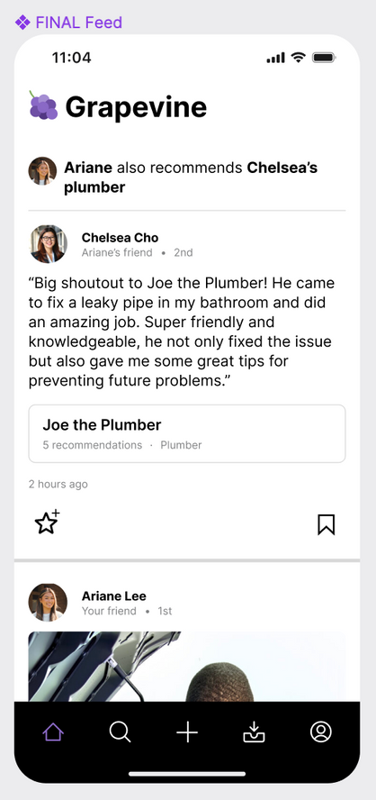
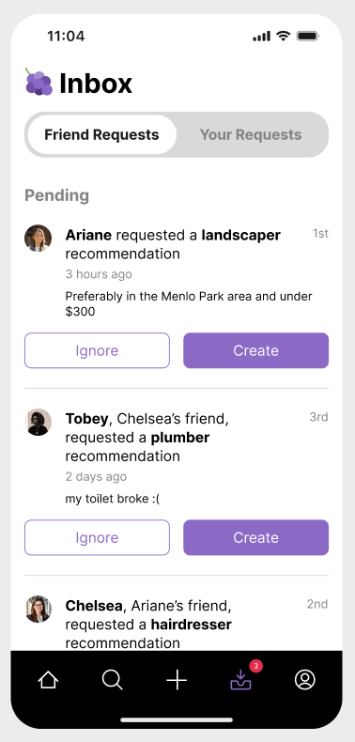
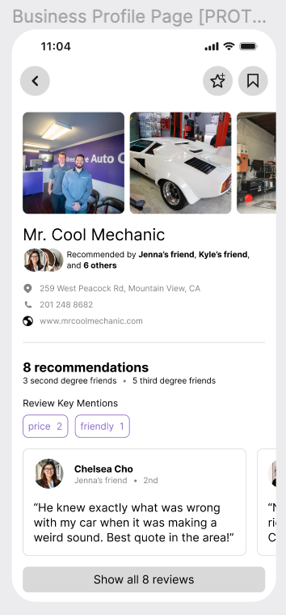
Hard-Coded
Back to Agenda Page
User profiles, business profiles
Recommendations
Recommendation requests
Generally, Figma did not let us flesh out the backend functionality of creating user profiles, managing friend networks, searching for recommendations, and sending out requests. Thus, many of these details are hard-coded to convey how our app would work from the user’s POV.

Slide 40
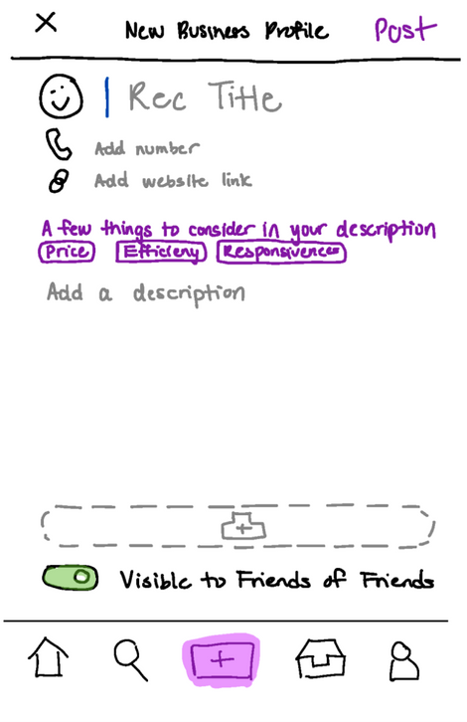
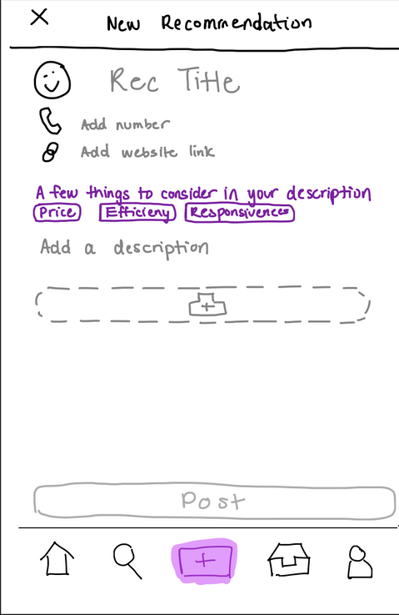
Other interface changes
Appendix
Last week, we noticed that some users were having trouble finding the “post” button after creating their recommendation
What we changed:
Post button enlarged, moved to the bottom of the page, and greyed out when not active
What we hope to achieve:
More intuitive posting experience

